Slide 1
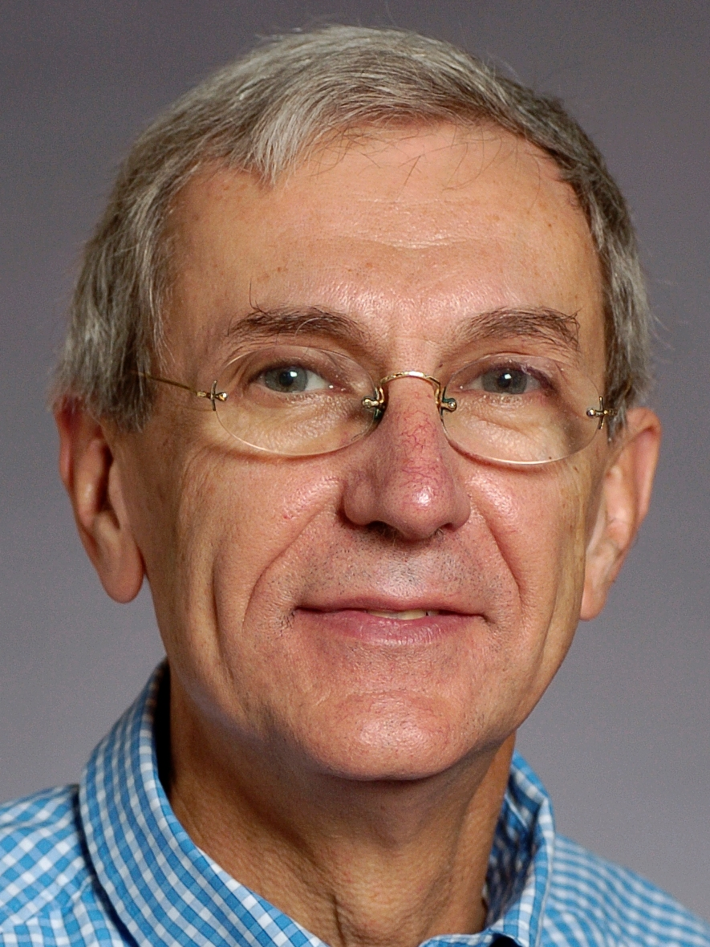
José M. F. Moura
Philip L. and Marsha Dowd University Professor, CMU
2017 IEEE Past Chair Technical Activities Board
Presentation for President Elect
August 11, 2017

Slide 2
Who Am I
Background: Born/ raised in Mozambique East Africa; EE @ IST, Lisbon, Portugal; D.Sc. @ MIT, Cambridge, MA, USA
Professor @IST, MIT, NYU, CMU, collaborations Europe, Asia
Interests: SP&data analytics, algorithms & applications
Academics+ind. broad exposure: Intel, Siemens licensed tech.; cofounder Spiralgen; detect. in >60% of hard disk drives
Career recognitions: IEEE & AAAS Fellow, NAI Fellow, NAE
IEEE: Co-founder Portugal Section, VP-TAB, Div. Dir., other IEEE Boards (PSPB Vice Chair, EAB, …), President SPS, EiC

Slide 3
My Aspirations for IEEE
Membership: stuck at 420K, S/C at 260K, possibly decreasing
Look outwards, turn the tide on membership, what does it take to double or reach the 1M mark?
Understand value proposition to different segments: YPs, diverse gender and regions and countries, professional interests
Go beyond academics journals and conf. to new type events (WiE type), professional growth, education, career progression, industry segments
New businesses that appeal to members and community at large
Balance IEEE Operation Budget: get rid of multimillion dollar operation budget deficit, corporate o/h, financial transparency, increase net revenue to member activities

Slide 4
What Type of Leader
As VP TAB last year set-up joint ad-hocs with other boards:
Joint MGA-TAB on membership looking at value proposition and types of membership to expand, retain, attract new members
TAB-EAB: leverage technology for education modules
Joint TAB-Standards: TechEthics – IEEE Leadership in ethical and social implications of technology
Identify pressing prob., focus organization in solution
Team player and doer
Thank you for listening.

