Slide 1
IEEE Executive Director’s Report
Jim Prendergast, IEEE Executive Director & CEO
IEEE Region 10 Meeting
Sections Congress 2017
11 August 2017

Slide 2
IEEE Membership Stats
All figures are end of June 2017
IEEE Total Membership: 363,725
Higher Grade Membership (without GSM): 270,802
Student Members (with GSM): 92,923
IEEE Region 10 Membership: 101,388
Higher Grade Membership (without GSM): 57,593
Student Members (with GSM): 43,795

Slide 3
Market Highlights

Slide 4
Region 10 leads in downloads from IEEE Xplore
6 of the top 10 countries in the world
#1 China
#6 South Korea
#2 USA
#7 United Kingdom
#3 India
#8 Japan
#4 Taiwan
#9 Canada
#5 Germany
#10 Australia
Data as of August 2016

Slide 5
Japan – By Market Type (US$10.6M)
Academic 56%
Japan Alliance of University Library Consortia for E-Resources (JUSTICE) $16.7M
81 members
Government 11%
National Institute of Information and Communications Technology $323M
Japan Patent Office $231K
Japan Science & Tech Agency $173K
Corporate 33%
Nippon Telephone & Telegraph Corp (NTT) $382K
Toshiba Corp $321K
Hitachi Ltd $341K
Panasonic Corp $319K
Academic | $6M
Government | $1.1M
Corporate | $3.5M
Total | $10.6M
all USD
Notes:
In Japan, 33% of sales come from corporations. This is the highest proportion of corporate business in Asia and the highest proportion worldwide outside of North America.

Slide 6
Japan – By Product (US$10.6M)
IEL | $ 8,017,746
ASPP | $ 982,830
ENT | $ 716,305
NM Subs | $ 322,351
POP All | $ 322,170
Others | $ 97,160
Standard | $ 80,930
IBM | $ 19,145
SMPTE | $ 13,085
all USD
Notes:
Approximately three-quarters of sales come from IEL subscriptions. The remainder comes from a mix of IEEE and third party subscriptions.
IEL - IEEE/IET Electronic Library
ASPP - IEEE All-Society Periodicals Package
ENT - Enterprise
NM Sub – Nonmember subscriptions
POP All - IEEE Proceedings Order Plans
SMPTE - Society of Motion Picture and Television Engineers

Slide 7
Japan YTD Highlights
New orders placed: YTD $264,060
28 ENT accounts total amount $146,770
Osaka Kogyo Daigaku Library – IEL $80K
Major prospects
FANUC – IEL $173K
National Inst of Advance Industrial Science & Tech – IEL + ENT $187K
IQ+ opportunities – NEC, Socionext, Kanagawa Prefectural Library
NII Archive deal potentially worth $580K
National Diet Library (NDL) – IEL + DDS $116K
Kanagawa Prefectural Library – IEL $173K
Challenges
Back-to-back Consumption Tax increase
Depreciating Japan Yen over the last 4 years
all USD
Notes:
Although the economy has been weak for the past decade, we have significant 2017 opportunity and have already secured $250,000 in new business year-to-date and forecast 5.9% growth in 2017
FANUC and NEC are both as is names of Japanese company, not acronyms.
IQ+ - InnovationQ Plus

Slide 8
China – By Market Type (US$20.9M)
Academic 81%
Digital Resource Acquisition Alliance of Chinese Academic Libraries (DRAA) $16.7M
174 members
Government 15%
Chinese Academy of Science (CAS) $1.83M
National Library Board (NLB) $183K
State Intellectual Property Office (SIPO) $406K
Corporate 4%
Huawei Tech $385K
Semicon Manufacturing Int’l Corp (SMICS) $159K
Spreadtrum Communications $131K
Academic | $17M
Government | $3.1M
Corporate | $0.88M
Total | $20.9M
all USD
Notes:
Corporations generate just 4% of sales in China. Government institutions generate 15% of sales
List of Corporates
CRRC Industrial Institute Co, Ltd.
Fujian Star Net Communication Co Ltd
Huawei Technologies Co Ltd IP Dept
North China Grid Co Ltd
Renesas Semiconductor Design (Beijing) Co., Ltd.
Semiconductor Manufacturing Intl Corp (Smics)
Shanghai Electric Group Co.,Ltd. Central Academe
Shenzhen Gigalight Technology CO., LTD
Spreadtrum Communications
State Grid Electric Power Company Shandong
Tencent
Zhejiang Energy Group R&D
Zte Corporation
List of Government
Academy of Mathematics & Systems Science CAS
China Academy of Info & Comm Tech
China Defense Sci & Tech Information Center
China Electric Power Research Institute
Chinese Academy of Sciences - (CAS)
Inst For Sci-Tech Information Of China
Institute of Automation, CAS
Institute of Computing Technology
Institute of Information Engineering,CAS
Institute of Science & Technology of China
Natl Library Of China (NLB)
Shanghai Advanced Research Institute
Shanghai Library
State Intellectual Property Office Of China (SIPO)
The Sci & Tech Library of Guangdong Province

Slide 9
China – By Product (US$20.9M)
IEL | $ 20,372,713
ENT | $ 125,295
ASPP online | $ 120,405
POP ALL | $ 81,095
Standards | $ 59,589
USB | $ 57,160
IBM | $ 53,554
CWG | $ 34,650
SMPTEJ | $ 9,820
all USD
Notes:
China generates more IP product revenue for the IEEE than any country outside the US.
A whopping 97% of the revenue is China is derived from IEL subscriptions
IEL - IEEE/IET Electronic Library
ENT - Enterprise
ASPP - IEEE All-Society Periodicals Package
NM Sub – Nonmember subscriptions
POP All - IEEE Proceedings Order Plans
USB - USB drives with IEEE content on them that we send to customers (who have a subscription) who want IEEE docs for backup
CWG – Corporate Workgroup
SMPTE - Society of Motion Picture and Television Engineers

Slide 10
China YTD Highlights
New orders placed $709K
Nexchip Semiconductor – Ent L2 + eLearning Lib $13K + $6K = $19K in April
$612K for 8 new schools (6 of 8 are cancelled schools in Nov 2016)
Tencent: upgraded from Enterprise L3 to IEEE Computing Library $27K; +$13K new sales; Tencent signed MOU with IEEE in May
Major prospects
Taobao.com – ENT L2 $14K
Shanghai HuaLi Microelectronics (HLMC) – IEL $131K (by Q2); will sign 3-years contract
State Grid Corporation of China (SGCC) Multi Sites – IEL $420K (by Q4)
China Consortium – IEL 7 new schools: $560K (orders in for 8 schools)
All-Society Periodicals Package (ASPP) 7 new prospects (small schools)
Challenge
Interface language still a barrier
all USD
Notes:
$612K for 8 new schools (6 of 8 are cancelled schools in Nov 2016; 19 schools cancelled in Nov 2016 because of delayed tender process; 2 of 8 schools are NEW/NEW)
China continues to be a growth opportunity for IEEE, with opportunity in the corporate segment and new universities joining the DRAA consortium

Slide 11
South Korea – By Market Type (US$9.13M)
Academic 75%
Korea Consortium $16.7M
81 members
Government 2%
Korea Intellectual Property Office (KIPO) - $181K
Corporate 23%
Samsung Electronics Co. Ltd $499K
Magnachip Semiconductor $165K
LG Display Co $103K
LG Electronics $239K
SK Hynix $198K
Hyundai Motor Company $187K
LIG Nex1 $177K
Hanwha Techwin Co Ltd. $128K
NAVER Corp $141K
SK Telecom $143K
Academic | $6.8M
Government | $0.22M
Corporate | $2.1M
Total | $9.13M
all USD
Notes:
In South Korea, 23% of IP product revenue comes from corporations. We have strong penetration across all segments.

Slide 12
South Korea – By Product (US$9.13M)
IEL | $ 8,544,135
ASPP | $ 200,286
POP All | $ 162,190
others | $ 58,766
eLearning | $ 40,590
Std - Draft | $ 38,780
IQ+ | $ 38,620
SMPTE | $ 18,870
M&C | $ 15,700
IBM | $ 11,210
all USD
Notes:
IEL - IEEE/IET Electronic Library
ASPP - IEEE All-Society Periodicals Package
NM Sub – Nonmember subscriptions
IQ+ - InnovationQ Plus
POP All - IEEE Proceedings Order Plans
SMPTE - Society of Motion Picture and Television Engineers
M&C - Morgan & Claypool

Slide 13
South Korea YTD Highlights
New orders placed: YTD $231,415
NAVER Labs $114,075
IQ+ – Samsung upgrade to unlimited IP range for $95K
IQ+ 3 new Corporate accounts:
Hyundai Motor
LG Electronics
NAVER Labs
Challenges
Local language barrier for engineers
Political instability
all USD
Notes:
Our new product designed for professionals working in the patent space, IQ+, has gotten exceptional traction in South Korea partly because of a very committed long time sales dealer.

Slide 14
India – By Market Type (US$16.89M)
Academic 81%
IEL IITs, IISs former RECs: 141 Schools
IEL VTU Consortium: 200 Schools
ASPP: 608 Schools
POP add on 147 Schools
Government 19%
DRDO,* ERNET,* CSIR,* ISRO, BARC
Corporate >1%
Samsung
Power Grid Corporation of India Limited
Infosys
Tata Consultancy Svcs Ltd.
KPIT
UnitedLex BPO Pvt. Ltd.
Bharat Heavy Electricals Ltd
Academic | $13.4M
Government | $300K
Corporate | $3.2M
Total | $16.9M
all USD
* Multi-year agreements
Notes:
India is the third largest market for IEEE IP products, following North America and China, with $16 million in sales forecast for 2017.
DRDO - Defence Research and Development Organisation
ERNET - National Research and Education Network
CSIR - Council of Scientific and Industrial Research
ISRO - Indian Space Research Organisation
BARC - Bhabha Atomic Research Centre

Slide 15
India – By Product (US$16.89M)
IEL | $ 11,719,982
ASPP | $ 4,296,323
POP | $ 664,560
Enterprise | $ 135,695
JLP | $ 33,895
NM Subs | $ 13,811
CWG | $ 12,075
eLearning | $ 8,925
IBM | $ 1,345
all USD
Notes:
IEL - IEEE/IET Electronic Library
ASPP - IEEE All-Society Periodicals Package
NM Sub – Nonmember subscriptions
IQ+ - InnovationQ Plus
POP All - IEEE Proceedings Order Plans
SMPTE - Society of Motion Picture and Television Engineers
M&C - Morgan & Claypool
CWG – Corporate Workgroup
JLP -

Slide 16
India YTD Highlights
India is the third largest market for IEEE IP products, following North America and China, with $16M in sales forecast for 2017
IEEE partners with a new dealer, EBSCO India, with emphasis on corporate sales
IEEE MSD and the IEEE Computer Society are working jointly with the new dealer to maximize revenue and minimize channel conflict
New Corporate
Electronics Corporation of India Limited
Power Research & Development Consultants Pvt. Ltd.
all USD
Notes:
India has been a very challenging market in recent years. The strong dollar, a new tax on IP products, and a decline in the number of engineering schools has caused a decline in academic revenue. To better manage the challenges we have contracted with a new sales dealer, EBSCO India, who began in mid - 2017. The initial signs are promising. Overall revenue is projected to increase modestly over 2016.
IEEE MSD and the IEEE Computer Society are working jointly with the new dealer to maximize revenue and minimize channel conflict.

Slide 17
India YTD Challenges
Academic revenue down as we continue to face a strong USD and “fewer engineering schools”
“275 Engineering Colleges have applied for Closure, AICTE Chairman Says” Times of India (Apr 2017)
“54% of Seats in Private Engineering Colleges went Vacant last year ” Times of India (Jul 2017)
New tax on IP products. Burden on subscribers now 18%
Overall revenue is projected to increase modestly over 2016

Slide 18
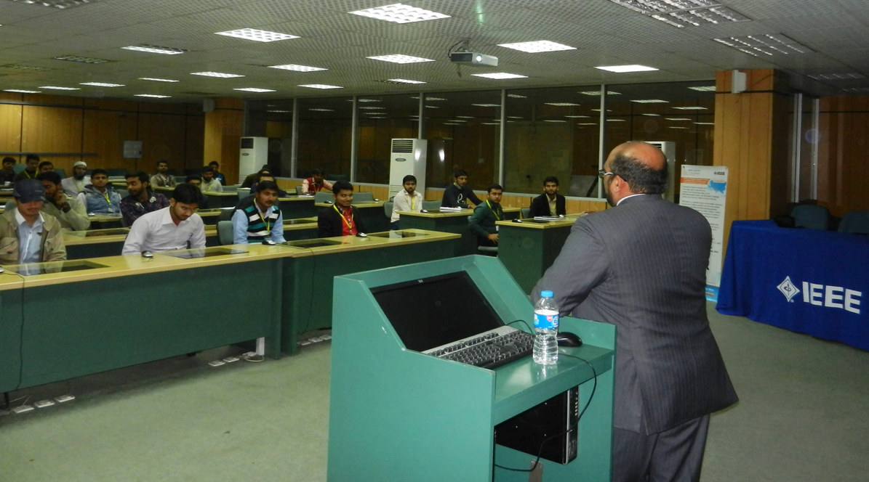
Pakistan
Higher Education Commission (HEC) consortium is a reliable IEL consortium of 40 universities (US$1.8M)
Our partner AJ Dektek is managing another nation-wide IEEE quiz and will visit over 50 schools to (re) introduce IEEE Xplore
This venue has been successful in the past and the audiences are very enthusiastic
Notes:
IEEE maintains a healthy and reliable consortium in Pakistan. In partnership with our sales dealer, we help run an annual quiz for all students at subscribing universities. The quiz raises awareness and drives usage of IEEE Xplore, thus supporting subscription renewals.

Slide 19
Products and Services

Slide 20
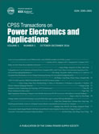
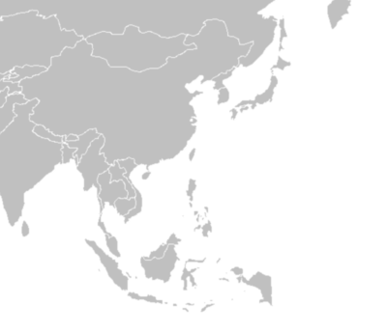
Expanding Research from China
Delivering more expert studies from Asia, a strong base for research
Three new Open Access journals from China were launched in IEEE Xplore in July
Chinese Journal of Electrical Engineering (CJEE)
Published by China Machine Press (CMP)
Transactions on Electrical Machines and Systems (TEMS)
Published by China Electrochemical Society (CES)
Transactions on Power Electronics and Applications (TPEA)
Published by China Power Supply Society (CPSS)
Asia Pacific represents 35% of IEEE content sales
(only 21% for the industry at large)

Slide 21
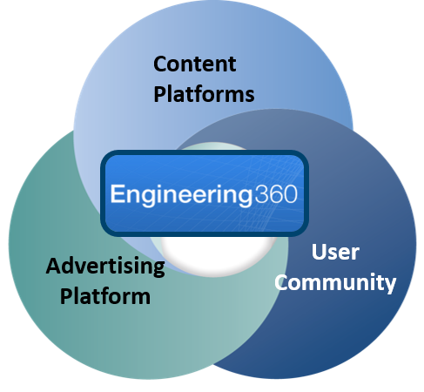
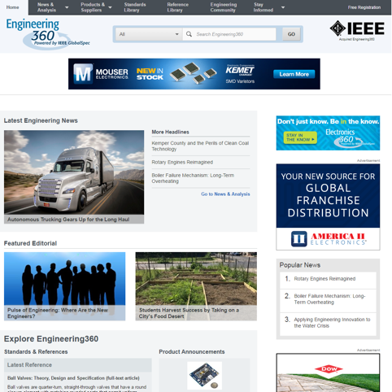
IEEE GlobalSpec Engineering360 Platform
Largest online destination for engineers and technical professionals
Business-oriented, content-rich marketing platforms that drive traffic and audience engagement
Provides advertisers with a multi-media platform to access and engage directly with the engineering community
www.engineering360.com www.electronics360.com www.datasheets360.com
Notes:
In April 2016, IEEE acquired GlobalSpec, a leading source of news, data and analytics for the global engineering and technical community including the widely known brand name platform Engineering360.
Engineering360 is the trusted and largest online destination for engineers and technical professionals. Industry-leading editorial team that creates original, insightful, and timely content that drives traffic and audience engagement
Provides advertisers with a multi-media marketing platform to access and engage directly with the engineering community:
Display ads
Webinars
Banners
Industrial ad network
Sponsorship
Content marketing
The new for-profit subsidiary of IEEE has been renamed IEEE GlobalSpec, Inc. and will significantly complement IEEE’s already broad offerings for engineers as well as its emerging position in research analytics, further fueling the organization’s value to industry through its business-oriented, content rich marketing platforms.
IEEE GlobalSpec At-A-Glance:
-More than 8 million registered users
-95 million technical documents
-200+ million datasheets
-220 million indexed technical webpages
-1,100+ annual newsletter editions
-200,000+ suppliers
-82,000 product announcements
-63,000 digitized catalogs
-835 specification guides

Slide 22
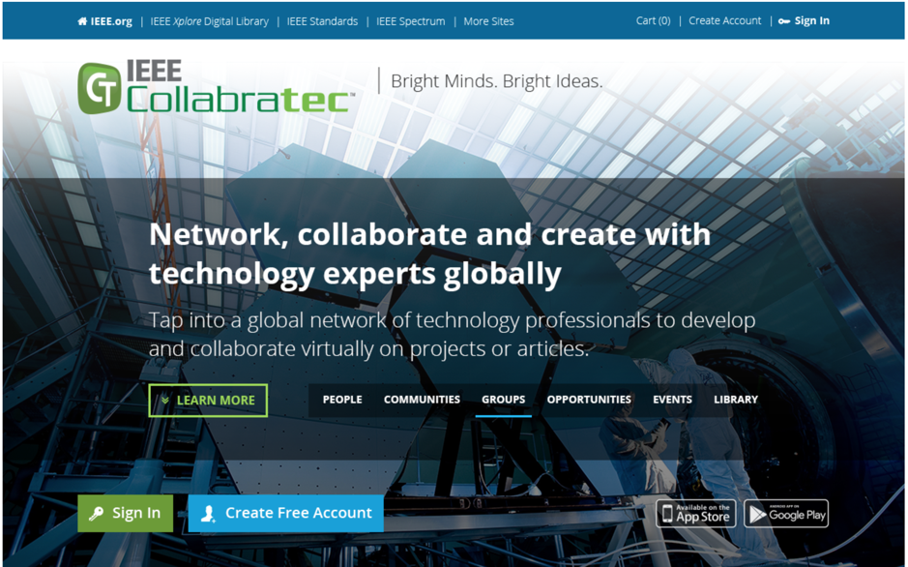
IEEE Collabratec™
Platform Sessions Jan – Jun 2017
Asia / Pacific | 42%
Americas | 38%
Europe | 13%
Africa | 7%
Release update
July: Enhanced communities and groups
August: Upgraded library with IEEE Xplore literature search, new features for members, performance upgrades
Upgraded home page
http://ieee-collabratec.ieee.org

Slide 23
IEEE Collabratec™
IEEE Members on Platform Top Countries - Jul 2017
USA | 10,940
India | 6,729
Canada | 1,540
United Kingdom | 994
Australia | 894
Brazil | 855
China | 784
Pakistan | 767
Membership development
2017 membership year – to date, converted 3,500 non-members on platform to IEEE and society members (2,750 in 2016)
Exclusive Benefits for Members
Verified Member status and grade badging
Members-only communities
Expanded groups privileges
Mentor matching
Downloadable Membership certificate
People filtering by members’ IEEE Section

Slide 24
IEEE Internet Initiative (3I)
Global Connect Initiative Digital Literacy Practicum in India
Participated in a briefing at the U.S. Embassy in New Delhi, India, on 19 April 2017
Part of the Bureau of Economic and Business Affairs’ Office of International Communications and Information Policy (EB/CIP) Digital Economy Officers Program to present educational sessions at posts overseas with U.S. Department of State policy makers and other stakeholders
3I Co-chair Deepak Maheshwari moderated the discussion, which included Anita Patil-Deshmukh, PUKAR (Partners for Urban Knowledge Action and Research) and Rajat Kathuria, Indian Council for Research on International Economic Relations (ICRIER), on:
Why digital literacy is important
Social inclusion and digital literacy
Digital literacy resources and opportunities for digital economy officers
http://internetinitiative.ieee.org/events/conferences/gci-digital-literacy-practicum

Slide 25
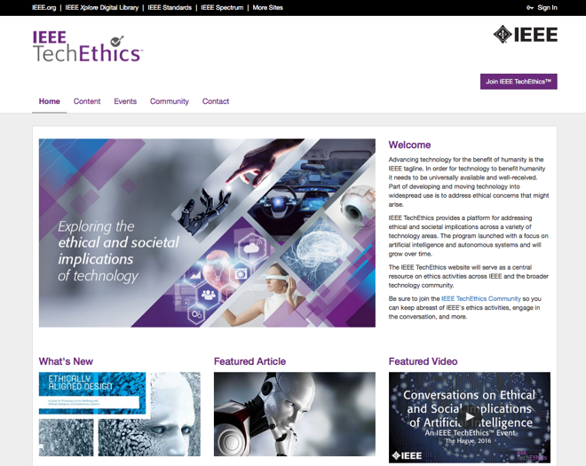
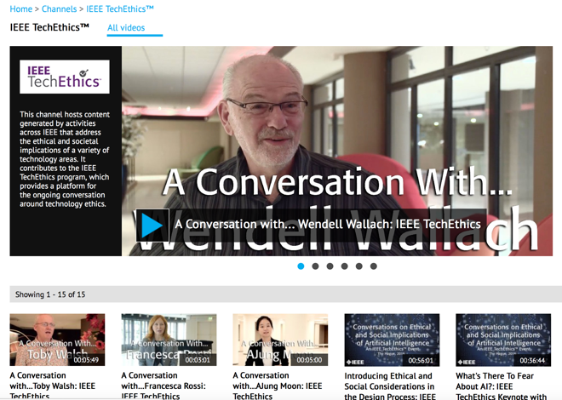
IEEE TechEthics™ Program
Institute-wide umbrella program led by Technical Activities
Website launched (techethics.ieee.org)
IEEE’s central hub of technology ethics information
New channel on IEEE.tv (http://ieeetv.ieee.org/channels/techethics)
Video content on technology ethics from across IEEE (TechEthics, EPPI, Spectrum, etc.)
Technical community created (techethics.ieee.org/join)
Establishes network of individuals (>400 so far) interested in tech ethics
Improved opportunity for targeted communication & collaboration
The Institute: Special themed May issue on Ethics in Technology (http://theinstitute.ieee.org/static/special-report-ethics-in-engineering)
First annual conference scheduled for 13 October in Washington, DC, USA
Collaborators currently include IEEE Foundation, IEEE Brain Initiative, IEEE Robotics & Automation Society, IEEE Standards Association, IEEE Spectrum, National Academy of Engineering, and Carnegie Mellon University

Slide 26
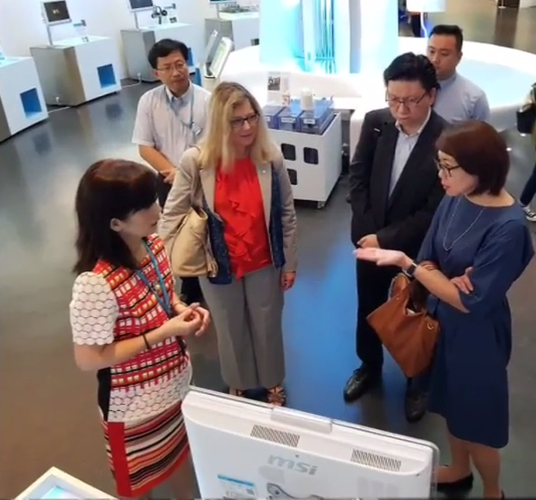
IEEE President’s Outreach in South Korea and Taiwan
Encouraging volunteer engagement and industry collaboration
Led by IEEE President Karen Bartleson, 12-21 July
Met with volunteers in the Seoul, Taipei, and Tainan Sections
Attended IEEE EMBC 2017 & IEEE Smart Tech 2017
Outreach visits:
Academia (National Cheng Kung University)
Industry (Chunghwa Telecom Lab, Hyundai Motors, Samsung)
Both government and nonprofit research & development organizations

Slide 27
Industry Advisor Board (IAB)
In the process of forming
Executives and technical leaders from industry, including:
1st meeting to take place in the Fall
Outcomes: trends in industry; advice on new products and services; identify and connect IEEE to new volunteer leaders
Alignment with other equivalent IABs or similar bodies in IEEE
Boeing
ComEd Utility
Hewlett Packard Labs
IBM Corporation
National Grid
NTT Electronics Co. Ltd.
SAIC / Alliant Energy
Schneider Electric Kenya Ltd.
Twitter
Unity Technologies

Slide 28
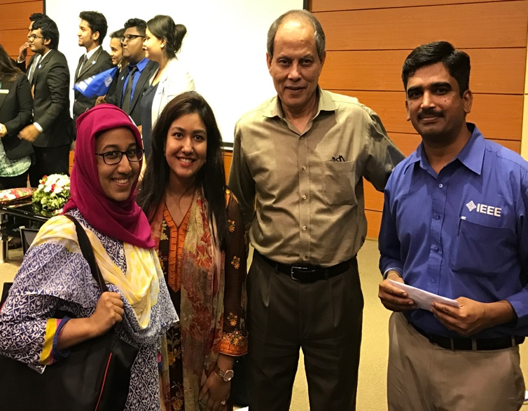
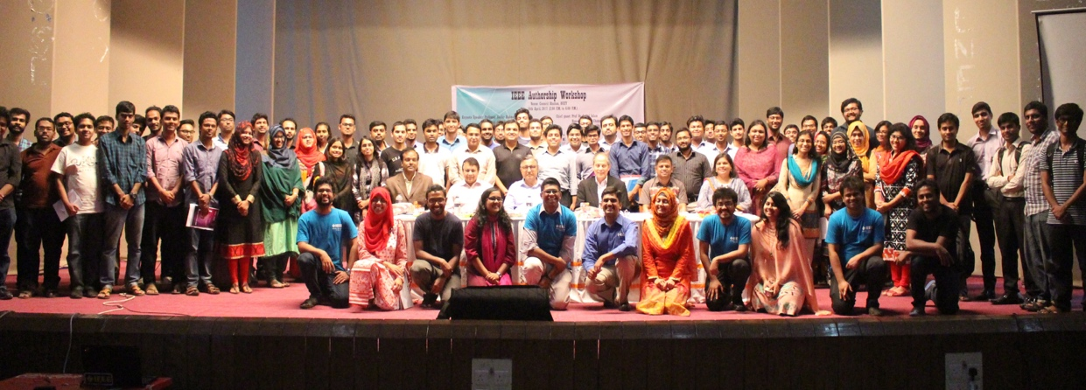
2017 IEEE Authorship Workshop
Training Bangladeshi academics on publishing studies with IEEE
How to Publish a Technical Paper with IEEE workshops at North South University and Bangladesh University of Engineering & Technology in April
Over 350 locals engineers attended the presentations by Professor Saifur Rahman, an IEEE Fellow and Joseph R. Loring Professor of Electrical and Computer Engineering from Virginia Tech
IEEE’s first Author Workshop in Bangladesh
Notes:
Providing the local engineering community with skills to advance their careers and expose their technology discoveries through publication in peer-reviewed scholarly journals

Slide 29
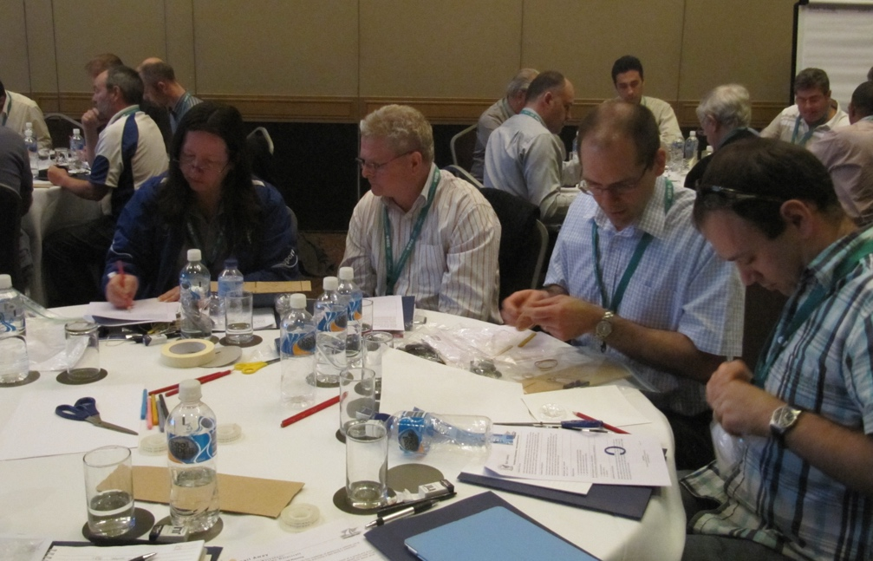
Teacher In-Service Workshop in Australia
Empowering teachers with engineering education
A Teacher In-Service Program (TISP) Training Workshop is scheduled for 14 August in Sydney following Sections Congress
Volunteers receive training on how to conduct professional development sessions for educators in their local area
Teachers learn how to integrate TryEngineering.org lesson plans and hands-on activities into the classroom
44 Volunteers are pre-registered to attend; representing 10 regions and 36 sections
Participants of a TISP workshop held in Brisbane, Australia

Slide 30
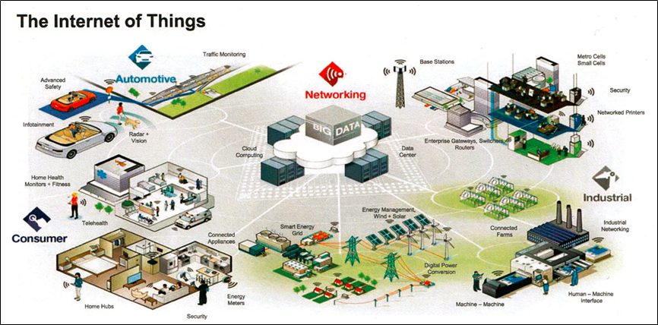
IEEE Guide to the Internet of Things Course Program
Launched by Educational Activities
In partnership with the IEEE Internet of Things (IoT) Future Directions Initiative
Eight-course program taught by world-renowned experts in IoT
Topics:
What IoT is … plus applications, challenges, and future opportunities
How the healthcare industry is using IoT to help other industries consider relevant applications of this technology
Real-life applications of the Social IoT, along with underlying architecture needed to support these applications

Slide 31
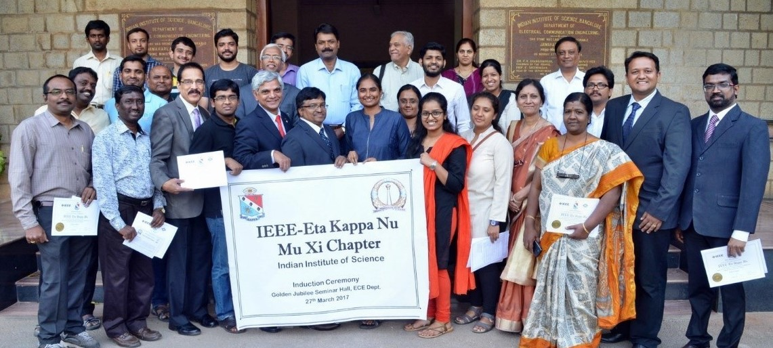
IEEE-Eta Kappa Nu Chapter Installations
Two new chapter installations in Region 10
IEEE-HKN Mu Kappa Chapter installed on 1 March at the University of Queensland, Australia
IEEE-HKN Mu Xi Chapter installed on 27 March at the Indian Institute of Science (IISc), Bangalore, India
Formation of this chapter is a result of the IEEE Board Industry Outreach meetings lead by Barry Shoop in Bangalore in August 2016

Slide 32
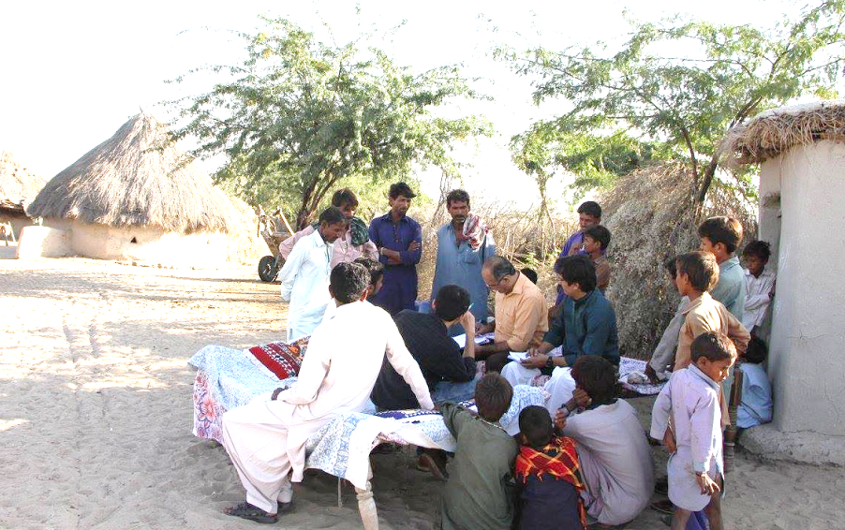
SIGHT Volunteers work to deliver reliable access to energy
The IEEE Karachi Section SIGHT chapter is working with the Association for Water, Applied Education, and Renewable Energy (AWARE), a local NGO, to install solar home systems in rural villages of the Umerkot and Tharparkar districts of southern Pakistan
The IEEE SIGHT Karachi team discusses issues in access to energy with community representatives

Slide 33
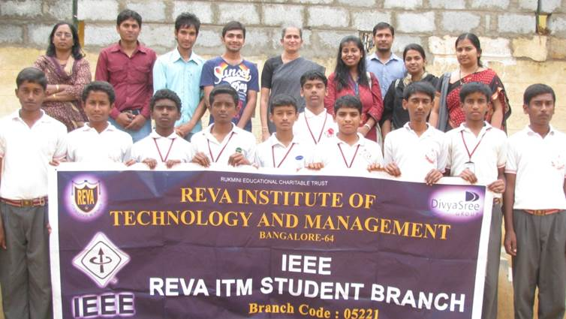
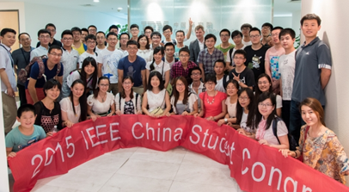
Region 10 highlights
34 of 95 (over 30%) of approved EPICS in IEEE projects have been in Region 10
$100,000+ USD has been awarded to projects within Region 10
Over 800 IEEE volunteers and students throughout Region 10 have been involved
Cardiac health care: exploring ICT for cardiovascular diseases using phonocardiography project in India
Education and outreach of electrical engineering and renewable energy project in China
Notes:
From powering villages with solar cells, to developing mobile devices for better healthcare screening, to connecting rural schools with technology…EPICS in IEEE enables IEEE volunteers and students to make a real difference in the lives of people in their communities around the world.

Slide 34
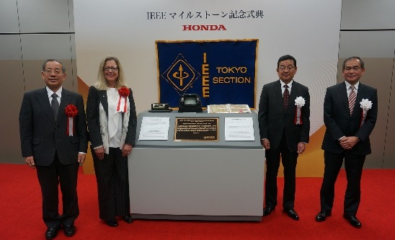
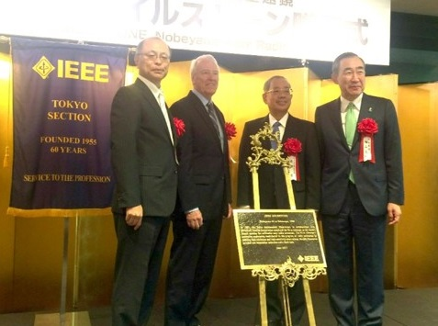
2017 IEEE Milestones in Region 10
Celebrated four dedications
Map-based Automotive Navigation System (1981) on 2 March (Tokyo Section)
Invention of a Temperature-Insensitive Quartz Oscillation Plate (1933) on 6 March (Tokyo Section)
Nobeyama 45-m Telescope (1982) on 14 June (Tokyo Section)
The Discovery of the Principle of Self-Complementarity in Antennas and the Mushiake Relationship (1948) on 27 July (Sendai Section)
180 milestones worldwide
34 milestones for Region 10
Iwao Sasase, IEEE Tokyo Section Chair; IEEE President Karen Bartleson; Takahiro Hachigo, President of Honda Motor Co. Ltd.; and Hiroyuki Matsumoto, President of Honda R&D Co. Ltd.
Dr. Masahiko Hayashi, Director General, National Astronomical Observatory of Japan; President-Elect Jim Jefferies; Iwao Sasase, IEEE Tokyo Section Chair; and Masaki Sakuyama, President & CEO, Mitsubishi Electric Corp.

Slide 35
2017 IEEE Technical Field Award Recipients
Recipients from Region 10
IEEE Masaru Ibuka Consumer Electronics Award: John O’Sullivan, Electrical Engineer (Retired), Taggle Systems, Everleigh, Australia; David Skellern, Chairman, CMCRC Ltd., Sydney, Australia; Terence Percival, Director (Retired), Broadband and the Digital Economy, NICTA, Northbridge, Australia
IEEE William E. Newell Power Electronics Award: Seung-Ki Sul, Professor, Department of Electrical and Computer Engineering, Seoul National University, Seoul, South Korea
IEEE Donald O. Pederson Award in Solid-State Circuits: Takao Nishitani, Principal, LAISIP, Kanagawa, Japan
IEEE Jun-Ichi Nishizawa Medal: Ching W. Tang, Professor, Hong Kong University of Science and Technology, Kowloon, Hong Kong and Professor, University of Rochester, Rochester, NY, USA

Slide 36
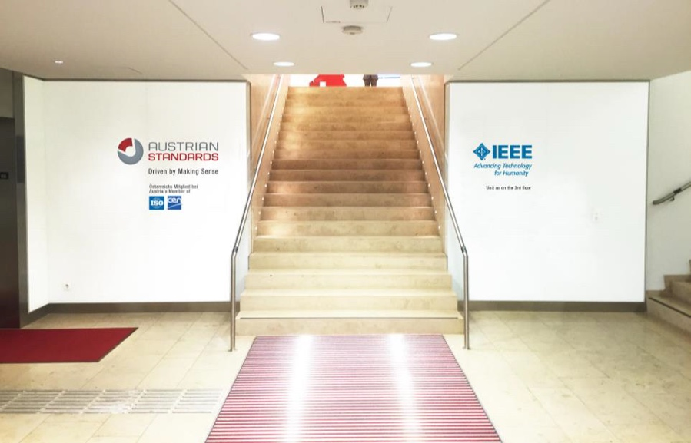
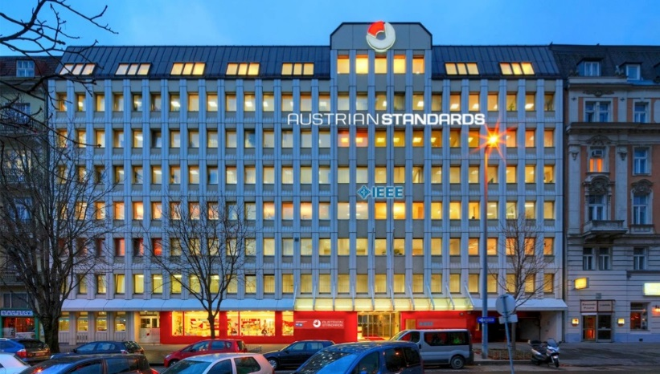
IEEE Technology Centre GmbH, Vienna
Co-located with Austrian Standards Institute (ASI)
Formal office opening ceremony 22 September
Two new professional staff based in Vienna:
Dr. Clara Neppel, Senior Director for European Business Operations
Dr. Hermann Brand, European Standards Affairs Director

Slide 37
Questions?

