Slide 1
Jacek Zurada, IEEE Life Fellow
Candidate for 2018 IEEE President-Elect
R10, Sydney, August 11, 2017 j.zurada@ieee.org www.jacekzurada.org

Slide 2
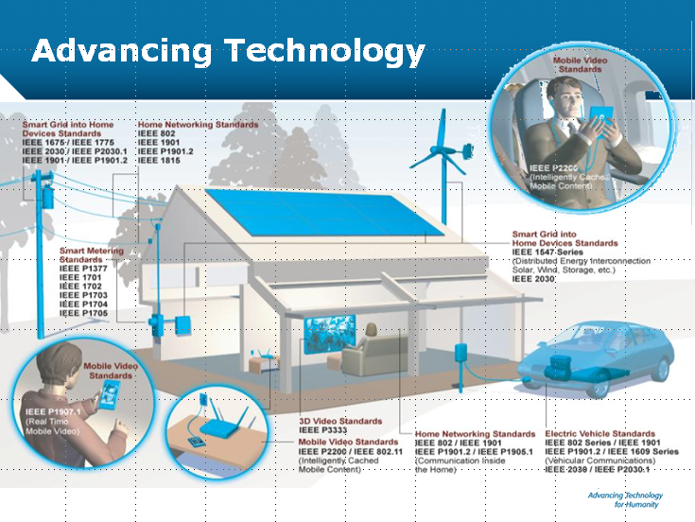

Slide 3
IEEE Universe
Societies, Councils, Technical Communities
Conferences and Events
1800
Periodicals
186
Educational
Activities
Regions, Sections,
Affinity groups,
Student branches
10/340/490/3000
Standards
1100
Chapters
2300
© Jacek Zurada

Slide 4
Goals
Better meet the needs of industry practitioners

Slide 5
Goals
Better meet the needs of industry practitioners
Improve the utility of IEEE Intellectual Property

Slide 6
Goals
Better meet the needs of industry practitioners
Improve the utility of IEEE Intellectual Property
Renew our focus on underprivileged or underrepresented groups, incl. new R10 focus

Slide 7
Goals
Better meet the needs of industry practitioners
Improve the utility of IEEE Intellectual Property
Renew focus on underprivileged or underrepresented groups, incl. new R10 focus
Improve collaboration between IEEE units and expand outside reach, global stature

Slide 8
Leadership experience
Leadership in three Boards: TA, MGA, PSPB
Chair:
  Technical Activities Board, V-Chair PSP Board
  TAB Strategic Planning
  TAB Management
  TAB Periodicals
  TAB Periodicals Review
  TAB Transactions
  TAB Globalization, Education (both adhoc)
  Computational Intelligence S. President, Editor-in-Chief, TNN
  AdHocs: EAB, IEEE-USA, Standards, TAB Finance

Slide 9
About Jacek Zurada
Select impactful IEEE initiatives (since 2007)
  Global T-t-T Workshops, incl. Asia
  Multi-year effort for TA financial transparency
  10 new Magazines for practicing engineers
  Launching educational TA S/C product lines
Technology is my passion (career of pubs, books, 10,800+citations), Neural Networks/ Computational Intelligence
Professor, University of Louisville, Kentucky
Strategy- and efficiency-oriented
Consensus builder, compassionate

Slide 10
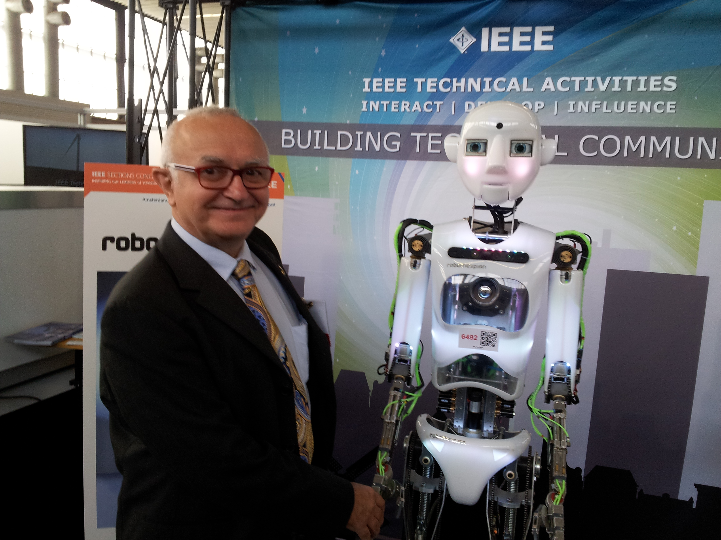
Jacek Zurada, IEEE-LF, for technology

Slide 11
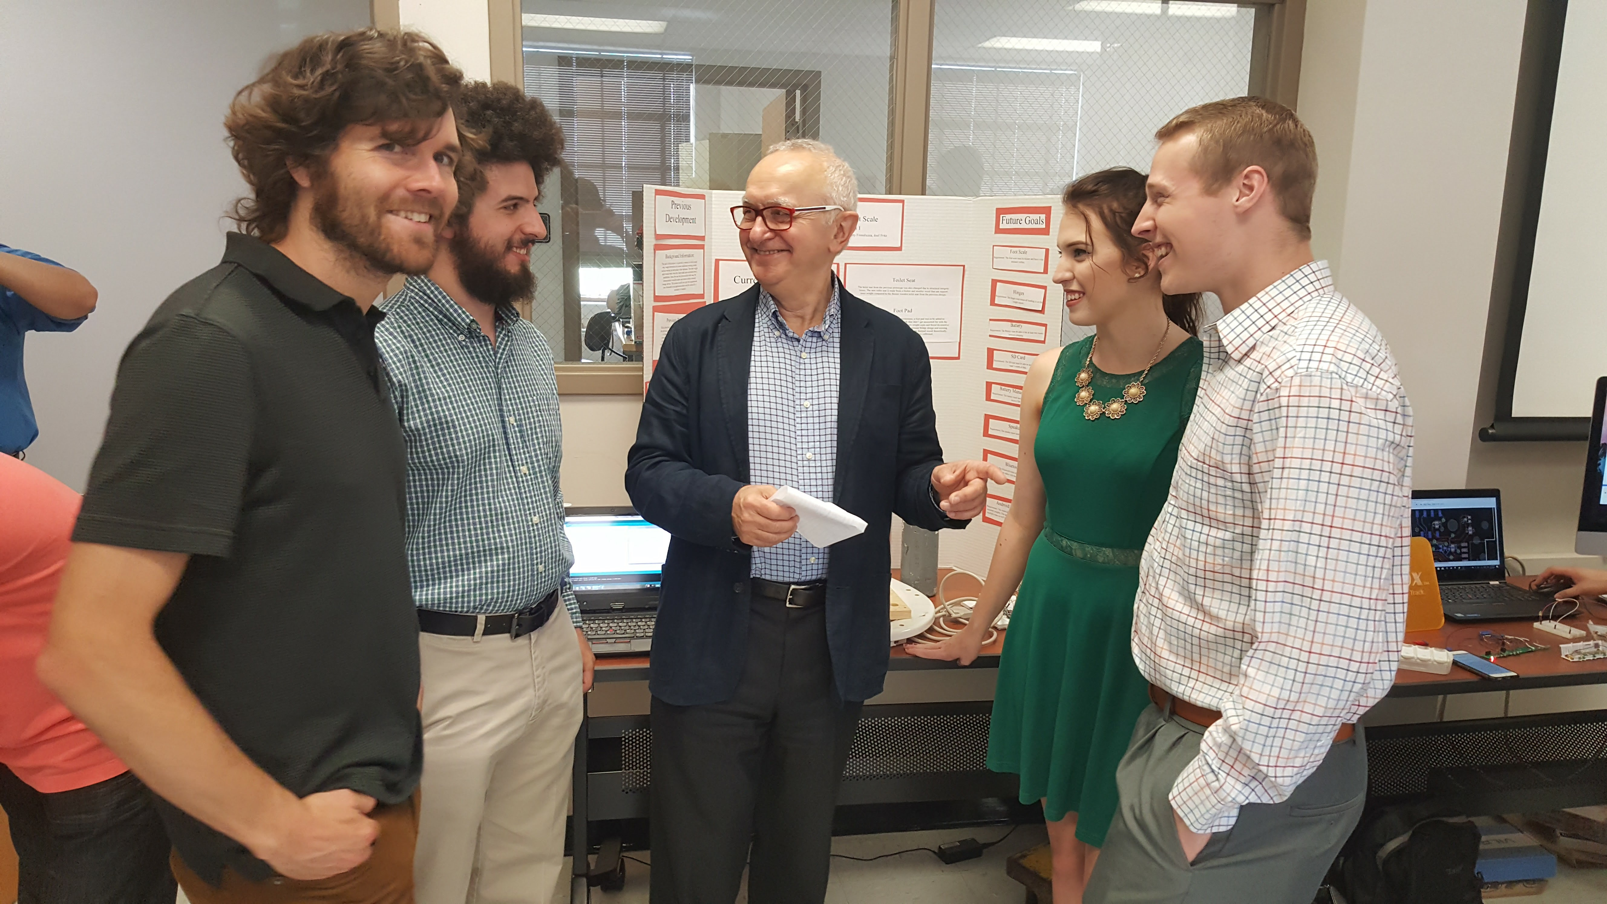
Jacek Zurada, IEEE-LF, for the people

Slide 12


ONE GLOBAL IEEE

