Slide 1
Embracing Young Professionals
Amsterdam, Netherlands
August 21, 2014
Tim Wong – Chairperson
IEEE Young Professionals

Slide 2
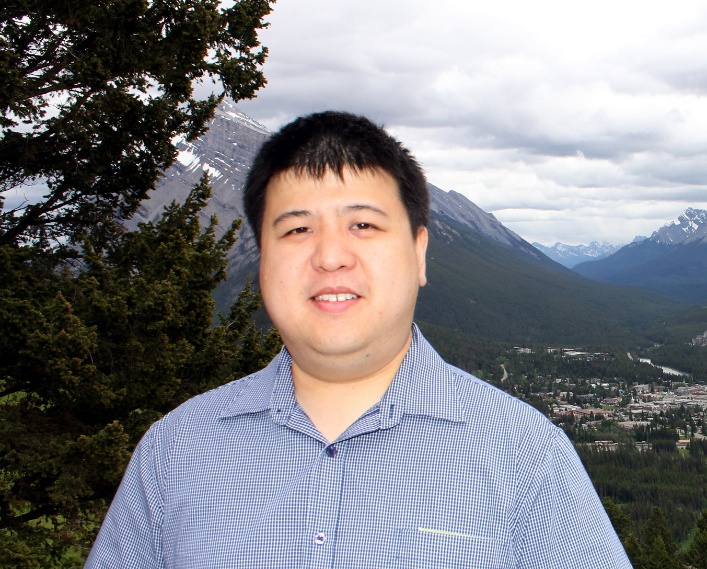
Introduction: Tim Wong
Chairperson – IEEE MGA Young Professionals.
Education: Electrical & Electronics Engineering, Computer Science and Finance.
Lives in Perth, Western Australia.
Hobbies include photography, finance, and networking.
Also volunteers on the Publication Services and Products Board and previously served as GOLDRush Editor-in-Chief and Region 10 GOLD Coordinator.

Slide 3
Our Mission
“To Inspire, Energize, Empower and Engage IEEE Young Professionals to envision and realize their dreams…”

Slide 4
Our Committee Structure
Chair
Past Chair
MELCC Partners
MGA Partners
VC, Leadership & Training
VC, Products & Services
VC, Strategic Partnerships
VC, Marketing & Communications
Regional Young Professionals Coordinators and their Affinity Group Chairs
IEEE USA Representative
GOLDRush Editor-in-Chief
TAB Reps & Liaisons
Society Reps
PSPB Rep
SAC/Young Professionals Liaison

Slide 5
IEEE Young Professionals
At a Glance
Mission: To Inspire, Energize, Empower, and Engage young professionals
to envision and realize their dreams.
54,252 globally, representing 15% of total IEEE membership
46,557 are Higher Grade/ 7,695 GSMs
Total of 179 Affinity Groups
70 in Regions 1-6
15 in R7
34 in R8
32 in R9
28 in R10
In 2014 GOLD changed it’s name to IEEE Young Professionals
This is not just a name change we are changing the member experience through new products and services and engagement strategies
Trending
Total June 2014 elevations to higher grade memberships – 14,314
Regions 8 - 10 have highest /most active Young Professionals membership

Slide 6
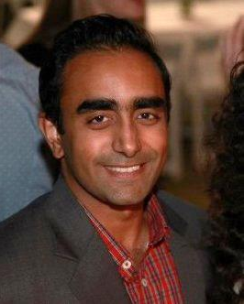
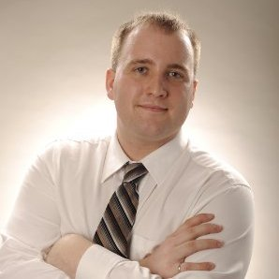
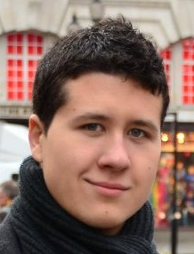
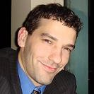
Vice Chairs and Focus Areas
Focus Area | Responsibility
Communications and Marketing Acting Vice Chair: Josheel Pranlal | Focuses on Market Development. Analyses and disseminates actionable membership data, oversees YP communications and stewards YP awareness, driving both member recruitment and retention.
Leadership and Training Vice Chair: Timothy Worboys | Focuses on Volunteer Development. Ensures that meaningful leadership opportunities and associated training, support and succession planning are available to empower volunteers.
Products and Services Vice Chair: Mario Milicevic | Focuses on Member Satisfaction. Provides the Young Professionals perspective as part of the design, development and evaluation of products, services and programs in IEEE OUs which bolster member engagement.
Strategic Partnerships Vice Chair: Robert Vice | Focuses on Partner Development. Fosters internal and external collaboration between IEEE societies, chapters and organizational units and encourages industry relations, enabling corporate partnerships and sponsorship.

Slide 7
History of IEEE Young Professionals
1996 IEEE Sections Congress included a breakout session "The Recent Graduate" -facilitated by Dave Kemp and Michael Van Chau (GOLD Pilot Leaders).
As a result of Recommendation #16 IEEE provided resources to establish GOLD programs in Sections, to help Sections identify potential GOLD members, and to assist recent graduates in finding GOLD programs.
1997 Regional Activities Board (RAB) approved the formation of the Graduates Of the Last Decade (GOLD) Committee.
The GOLD Committee will serve the interests of members in their first ten years (approximately) after graduation.
1998 The GOLD Committee charter is approved by RAB.
2009 A new GOLD vision and mission were developed to meet the IEEE Member and Geographic Activities Board’s (MGA) goals.
2013 The MGA Board approved the name change from GOLD to Young Professionals and a change in the member demographic. IEEE Young Professionals now serves members during the first 15 years after graduation with an option to opt-in.

Slide 8
Past Young Professionals Chairs
Year | Name
1998 | Mike Van Chau (Region 5)
1999-2000 | Scott Blair (Region 5)
2001-2002 | Slawo Wesolkowski (Region 7)
2003 | A. Anoop (Region 10)
2004 | Ivan Jileta (Region 9)
2005 | Gerald Anleitner (Region 8)
2006 | Darrel Chong (Region 10)
2007-2008 | Soon Wan (Region 1)
2009 | Adrian Pais (Region 8)
2010-2011 | William Somerville (Region 4)
2012 | Eva Lang (Region 8)
2013-2014 | Tim Wong (Region 10)

Slide 9
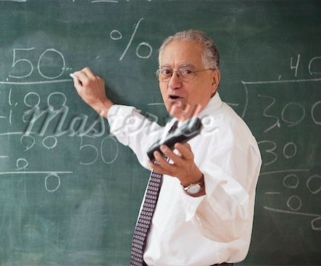
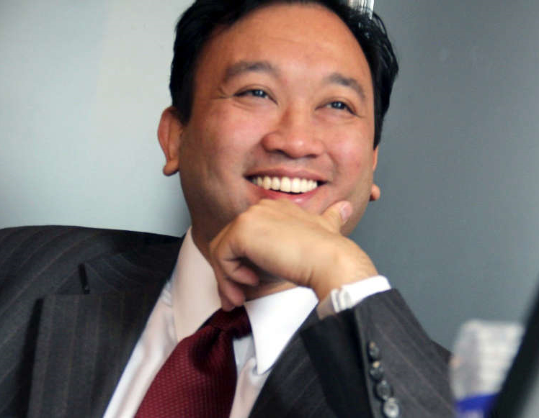
Where do we play a role?
Segment 5
- At IEEE for Technical Content.
- Not connected to mission of IEEE
- Tend to have language barriers
Segment 1
- Disengaged older members
- Not inclined to give back to IEEE
- Prefer others to lead
- IEEE mission is less relevant
Segment 4
Younger members
Want to be more involved
Do not know how
Don’t feel invited
Feel products difficult to use
Lowest satisfaction
Segment 3
Engaged Older members
More concentrated in educational institutions
Interested in sharing with others
They are actively involved with both networking and volunteering.
Most satisfied with IEEE
Segment 2
Young members
Connected to IEEE’s vision
Want to be more involved
Career services, networking, continuing education are very important
Use Social Media
* Higher Grade non-GSM, see Jamie (j.moesch@ieee.org) for student segments

Slide 10
Changing to Young Professionals
The MGA GOLD committee voted to changed its name to IEEE Young Professionals in May 2013.
The MGA Board approved the name change and Young Professionals criteria broadening the scope of Young Professionals membership from “ten years from first degree” to “fifteen years from first degree” with an option to participate beyond the fifteen year time span.
The IEEE Board directed all organizational units, to review and update their governing documents, replacing the term GOLD with Young Professional(s).

Slide 11
The Rationale Behind the Criteria
Age is sensitive transculturally, and does not necessarily correlate with early career need.
Date of birth is not a required field in the member record/database.
Universal indicator with opt in/opt out provides the member with control of their Young Professionals membership.
Organizing units maintain control with regard to volunteer service, continuing to use their own nominations and appointments processes.

Slide 12
Young Professionals Rebranding activities
Changes to Young Professionals LinkedIn, Facebook and Twitter Pages
Roadshow presentations to: MGA, PSPB, IEEE USA
The Institute “Call Us Young Professionals Please”
Advert in the IEEE Potentials
Pull up banner and marketing materials being developed

Slide 13
Communications to Members
Monthly Newsletter – “Three things you need to know this month.”
“Making the Switch” Webinars
Articles / Features promoting the new YP:
The Institute, Spectrum, Society Newsletters and Potentials
Featured in VOLT and MD Webcasts
Social Media channels
Facebook page
Facebook and LinkedIn Groups
LinkedIn Company Page
GOLDRush Blog being revitalized
New Twitter account
Youtube and IEEE.tv channel

Slide 14
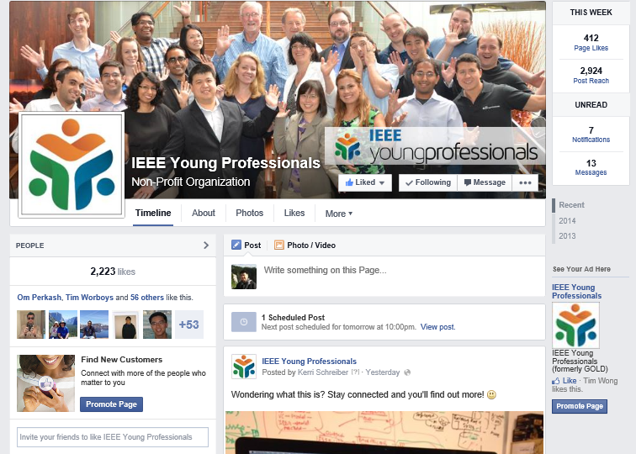
Facebook Young Professionals Page

Slide 15
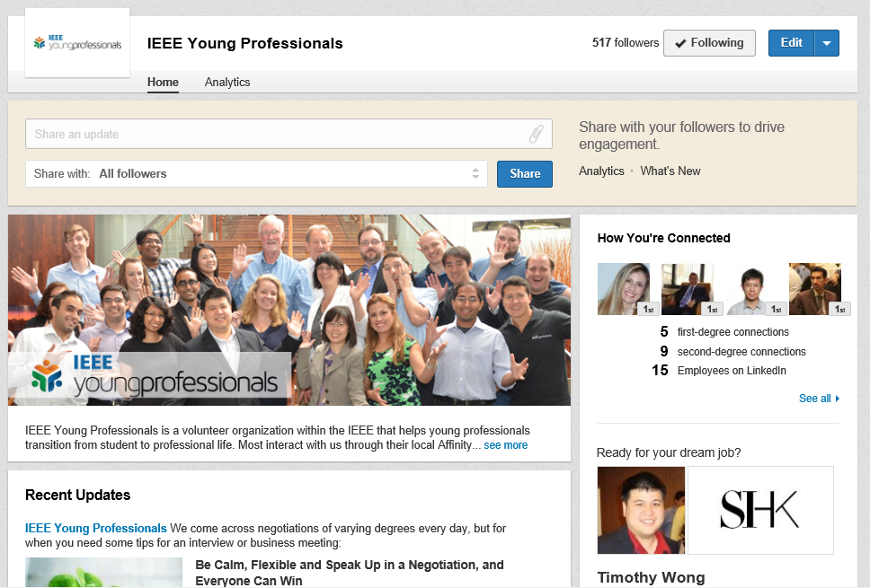
LinkedIn Company Page

Slide 16
Webinar Program
Monthly webinars
February 2014: “Leadership Excellence, Part 1”
March 2014: “Best of CES”
April 2014: “Electromagnetic Compatibility Society Webinar”
April 2014: “Humanitarian Frameworks”
May 2014: “Leadership Excellence, Part 2”
June 2014: “Stay efficient while being busy” (WIE collaboration)
July 2014: “Leading world class organizations”
August 2014: “Why Engineering Matters for Women”
…many more!
Webinar team
Mathew Carias, Toronto Section
Simay Akar, Turkey Section

Slide 17
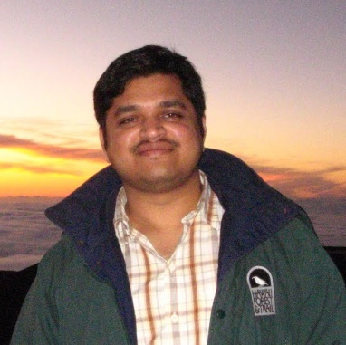
Career-Based Services
Launched in 2013: http://mentoring.ieee.org/
Online career mentorship tool for both mentors and mentees
Mentor and mentees connect based on technical/professional interests
Launched in early 2014: www.ieee.org/resumelab
Suite of online resume/CV development tools for each step of the job seeking process
Career-Based Services team
Venkata Chivukula, Eastern North Carolina Section

Slide 18
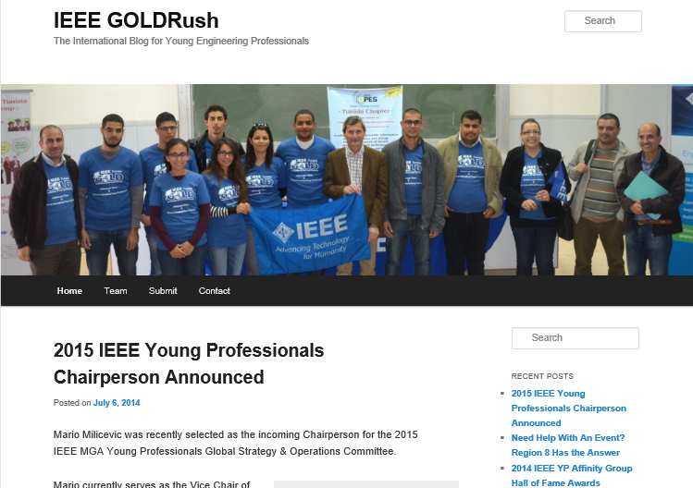
IEEE GOLDRush
www.ieeegoldrush.org
Featuring IEEE Young Professionals member and volunteer news and announcements.
Contributions should be sent to: goldrush@ieee.org

Slide 19
More Information
www.ieee.org/yp
http://www.facebook.com/ieeeyp
http://twitter.com/ieeeyp
http://www.linkedin.com/company/ieee-young-professionals
Email: young-professionals@ieee.org

