Slide 1





How Your Section Can Benefit
from IEEE-ETA KAPPA NU (IEEE-HKN)
Presentation to Region 10
22 August 2014
Douglas Gorham, Managing Director, EA
Nancy Ostin, Director, IEEE-HKN
1 7/28/2014
1

Slide 2

What is IEEE- Eta Kappa Nu? (IEEE-HKN)
The Honor Society of IEEE
Recognizes scholastic and professional achievements of individuals
IEEE-HKN is an early indicator of success, motivation, and leadership ability
Based on the highest ideals of our profession: hard work, sound judgment, service to others, and ethics
Invitation criteria includes: Scholarship, Character, and Attitude
Chapters are University based
Tradition that dates back to 1904
2

Slide 3
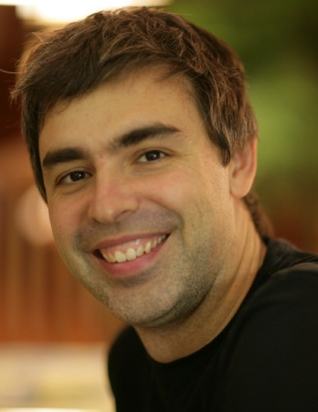
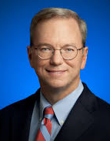
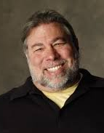
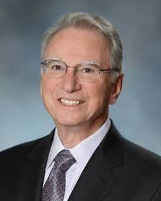
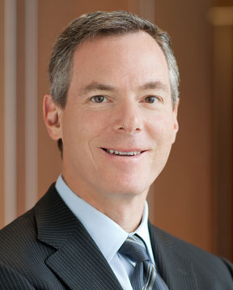
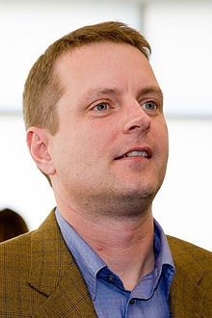
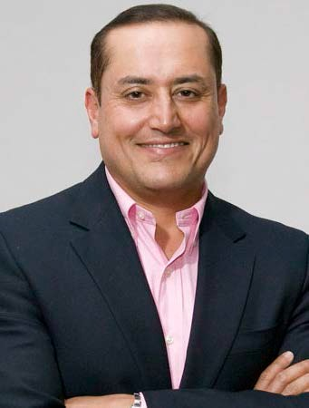
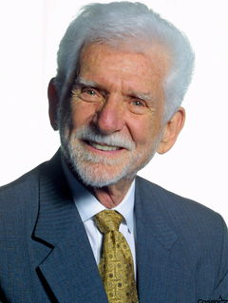
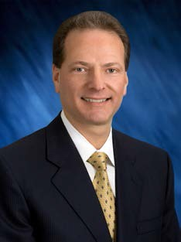
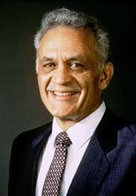
Who is IEEE-HKN?
Larry Page Founder of Google
Eric Schmidt
CEO of Google
Steve Wozniak
Founder of Apple
Paul and Irwin Jacobs
Founders of Qualcomm
David Filo Founder of Yahoo!
Sabeer Bhatia Founder of Hotmail
Martin Cooper Conceived the first handheld mobile phone
Henry Samueli Founder of Broadcom
Amar Bose Inventor of Bose Speakers
3

Slide 4
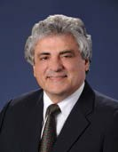
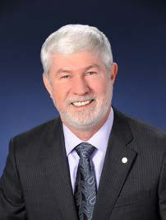
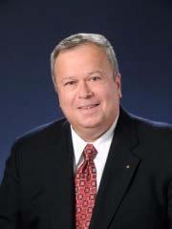
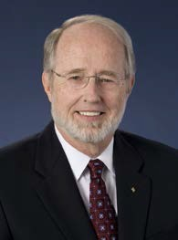
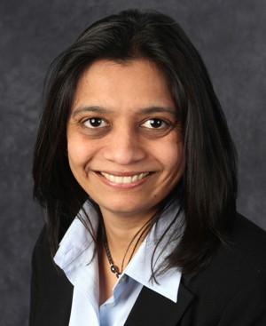
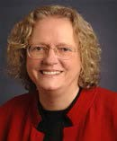
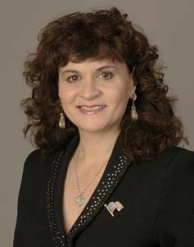
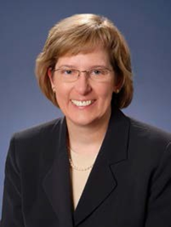
Who is IEEE-HKN?
Roberto de Marca
2014 IEEE President
Howard E. Michel
IEEE President-Elect
Moshe Kam
IEEE Past President
Gordon Day
IEEE Past President
Nita Patel
Chair , WIE;
IEEE-HKN Board of Governors
Leah Jamieson President, IEEE Foundation;
IEEE Past President
Karen Panetta
Chair, EAB ARC;
Vice-President, Communications IEEE-USA
Cecelia Jankowski Managing Director ,
IEEE MGA
4

Slide 5
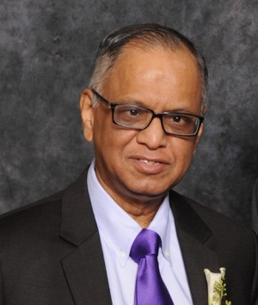
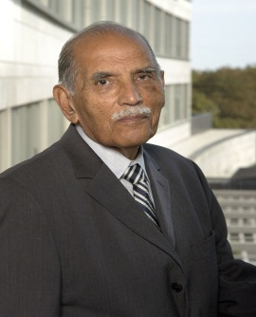
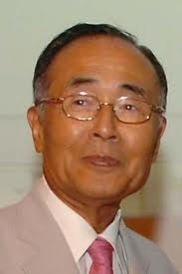
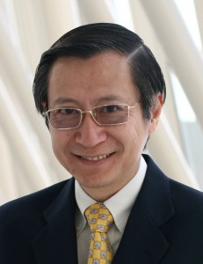
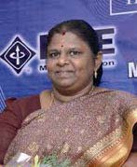
Who is IEEE-HKN?
Narayana Murthy
IEEE-HKN Eminent Member
Infosys Limited
Dr. F.C. Kohli
IEEE-HKN Eminent Member
Tata Consultancy
Dr. Jung Uck Seo
IEEE-HKN Eminent Member
Past Region 10 Director
Lawrence Wong
Past Region 10 Director
Ramalatha Marimuthu
IEEE EAB;
Past Chair , IEEE WIE
Paul Cheung
IEEE Foundation Treasurer
5

Slide 6
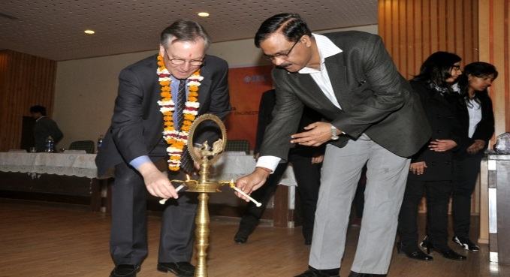
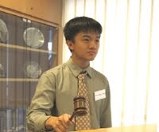
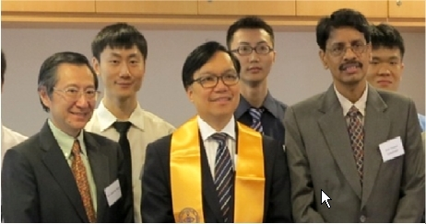
IEEE-HKN Chapters in Region 10
Lambda Eta chapter at
Bharati Vidyapeeth's College of Engineering in New Delhi, India
Lambda Omega chapter at
National University of Singapore
Lambda Iota chapter at the University of Hong Kong
6

Slide 7
How IEEE-HKN Works with Sections and Student Branches
There are several organizational models for success. Any model can be customized to meet the needs of your Section and Student Branch
IEEE-HKN chapters and IEEE Student Branches operate independently
IEEE-HKN chapters and IEEE Student Branches collaborate occasionally on projects
IEEE-HKN chapters and IEEE Student Branches work side-by-side, collaborating on several shared projects and goals
7

Slide 8

How Your Section Will Benefit
IEEE-HKN Enhances Your Current Student Program
New Student Members
Increased Student Retention
Increases Volunteerism
Development of future leaders
Commitment to helping others
Lambda Omega Chapter
National University of Singapore
8

Slide 9
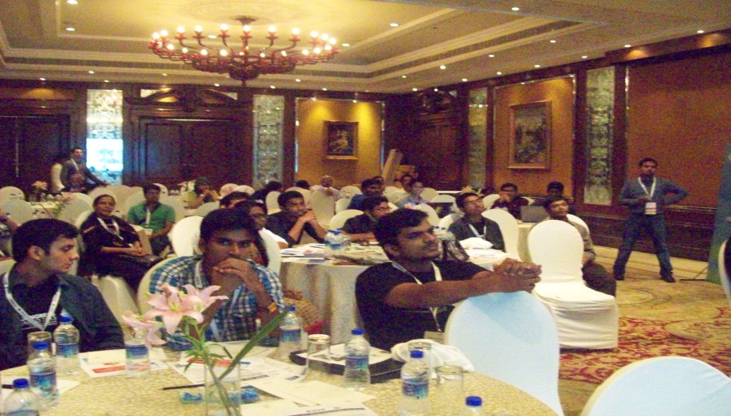
How the University Will Benefit
IEEE-HKN Chapters Add Value by Providing Service to Others
Tutoring
Peer mentoring
Ambassadors
Pre-University Outreach
Community Service
IEEE-HKN Chapters Add Prestige
Encourage the highest ideals and principles of our profession
IEEE-HKN Chapters Add Visibility
Represent their university with integrity, quality and accomplishments
Lambda Eta Chapter
Bharati Vidyapeeth's College of Engineering
9

Slide 10
How the Individual Will Benefit
Recognition
IEEE-HKN induction is an acknowledgement of accomplishment
Life-time Designation
Once inducted, you retain the designation for life
Professional Development
Unique opportunities to develop leadership skills
Networking with peers and professionals
Opportunity to Contribute to THE BRIDGE
THE BRIDGE, IEEE-HKN’s online magazine, provides an opportunity for students and alumni to contribute
    The November 2014 issue will feature 4 student research papers
    Distribution to more than 112,000 readers
10

Slide 11
How to Form an IEEE-HKN Chapter
1. Establish a Group of Interested
Parties
Submit the IEEE-HKN New Chapter Inquiry Form at www.hkn.org
2. Prepare and Submit Your Application
At least 8 qualified students must be identified. You may also induct faculty & graduate students.
3. Prepare and Submit Chapter
Operations Manual
4. Application & Chapter Operations Manual Reviewed for Approval by the IEEE-HKN Board of Governors
5. When Approved: Elect Officers Plan Activities
6. Plan Chapter Installation &
Induction; Invite
VIPs, Alumni and Local IEEE Leadership
(IEEE-HKN HQ will help schedule ceremony)
11

Slide 12
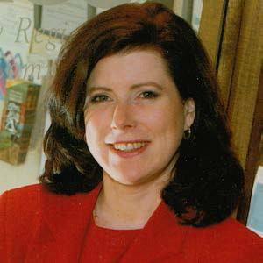
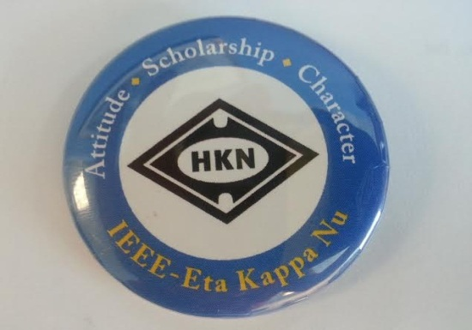
Questions?
Tweet your questions and follow the conversation at @IEEE_EtaKappaNu or #IEEEHKN
Visit the Educational Activities Booth for more information
Ask Nancy Ostin - Director, IEEE-HKN n.ostin@ieee.org or www.hkn.org
Find an IEEE-HKN Member
  - Look for the IEEE-HKN button
12

Slide 13
BACK UP SLIDES
More Information ….

Slide 14
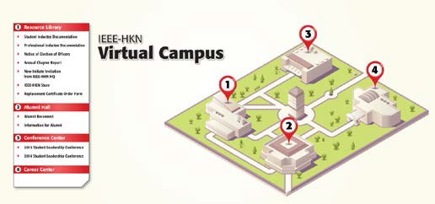
To find out more about IEEE-HKN
Use QR code to access our “Form a Chapter” resource
Visit our website: www.hkn.org
Email: info@hkn.org
Facebook: www.facebook.com/IEEE.HKN
LinkedIn: “IEEE-Eta Kappa Nu” group
Visit our Virtual Campus for webinars, training, resources, alumni reconnection and more
13

Slide 15
Other Important Information
Chapters may induct faculty, graduate, and post- graduate students; chapters may also induct professionals (must be IEEE members)
IEEE-HKN is a lifetime designation with only a one-time fee at the time of induction
All IEEE-HKN student inductees receive one year of IEEE student membership as a benefit
Are you an IEEE-HKN alum? If so, check your IEEE membership card…if it is not on your card, it is not in your record. Contact info@hkn.org to update your card
Want to find alumni in your Section? Just ask us!
14

Slide 16
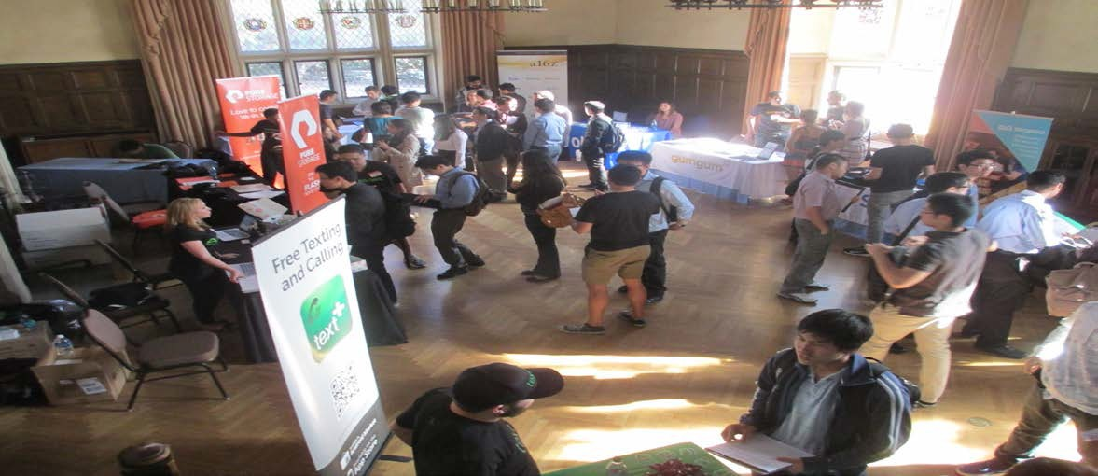
Leadership
IEEE-HKN Chapters organize programs at all levels, such as: mentoring underclassmen and transfers; hosting tech talks and career fairs; supporting robotics clubs and local non-profit groups
Epsilon Nu Chapter
University of California – Los Angeles
15

Slide 17
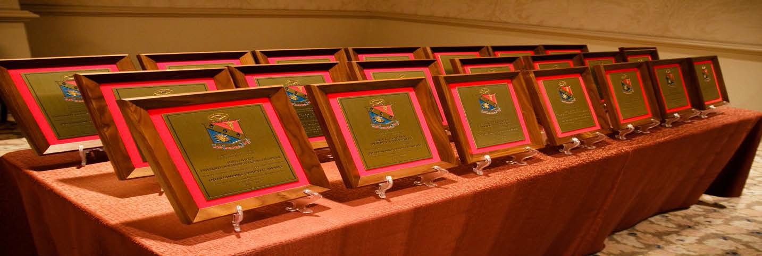
Community Involvement
The 23 Chapters recognized as OUTSTANDING CHAPTERS in 2012 contributed more than 50,000 hours of community service – more than 50 hours per person
Outstanding Chapter Award Ceremony
16

Slide 18
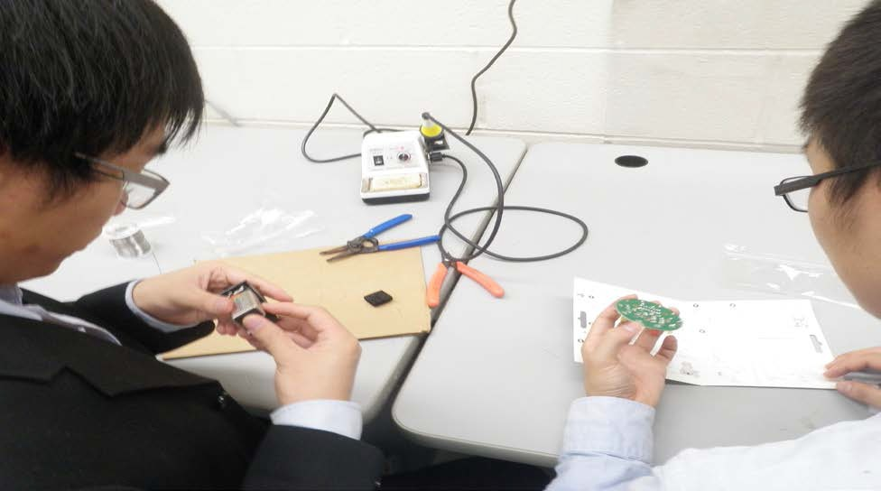
Service
IEEE-HKN Chapters are expected to serve others: their department(s), their peers, their university, their section, and their community
Theta Mu Chapter
State University of New York – Stoney Brook
17

Slide 19












Who is IEEE-HKN?
IEEE-HKN members are on the Board of Directors at many top tech companies including Google, IBM, Yahoo!, Motorola, GE, Qualcomm, Apple, Boeing, Facebook, Microsoft, TI, National Instruments, and more
18

